Slide 1

MTN Customer Churn Analysis Dashboard
Turning Customer Data into Strategic Business Insights using Power BI
Yakub Olawale Moshood

Slide 2
Project Overview
Customer retention is one of the most critical success factor in the telecommunication industry. Acquiring new customer is significantly more expensive than retaining existing ones, making customer churn a major business concern. This project was develop to analyze customer behavior, identify the factor contributing to churn, evaluate revenue performance, and provide data-driven recommendations that support strategic decision making.
I transformed raw customer data into an interactive Business intelligent solution consisting of five executive dashboard designed to help management understand customer trends and improve retention strategies.
Business Problem
Customer churn remains one of the biggest challenges facing telecommunication companies. Losing existing customers reduces recurring revenue, increases customer acquisition costs, and weakens long-term profitability.
This project leverages Business Intelligence to identify customer churn patterns, understand revenue performance, and recommend strategies for improving customer retention.
The objectives of this project are to:
Monitor customer churn performance.
Analyze customer demographics and behavior.
Evaluate revenue contribution across customer segments.
Identify the major causes of customer churn.
Develop actionable recommendations for improving customer retention.

Slide 3
Project Workflow
Dataset Overview
Dataset Summary
Business Intelligence Lifecycle Create a flow diagram: Business Problem ↓ Data Collection ↓ Data Cleaning ↓ Data Modeling ↓ Power BI Development ↓ Dashboard Design ↓ Business Insights ↓ Strategic Recommendations
Key Variables * Customer ID * Age * Gender * State * Device * Subscription Plan * Revenue * Satisfaction * Tenure * Churn Status * Churn Reason
Metrics | Vaues
Records | 496 Customers
Revenue | ₦68.75 Billion
State | Nigerian States
Time Periods | January–March 2025

Slide 4
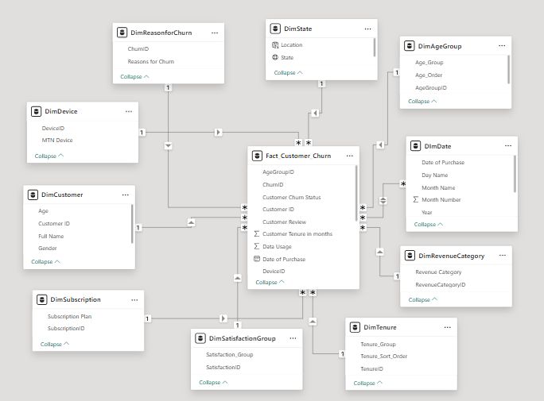
Project Workflow
Data Model Star Schema Architecture

Slide 5
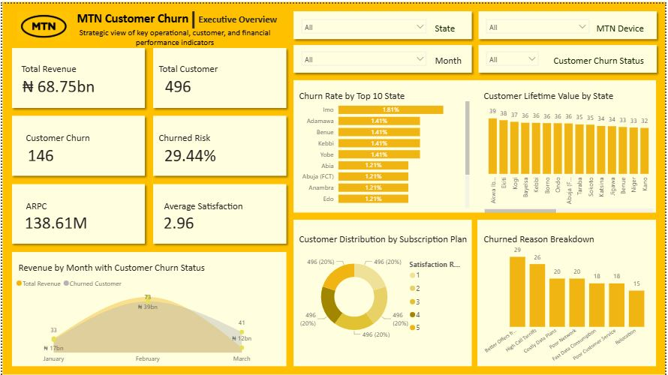
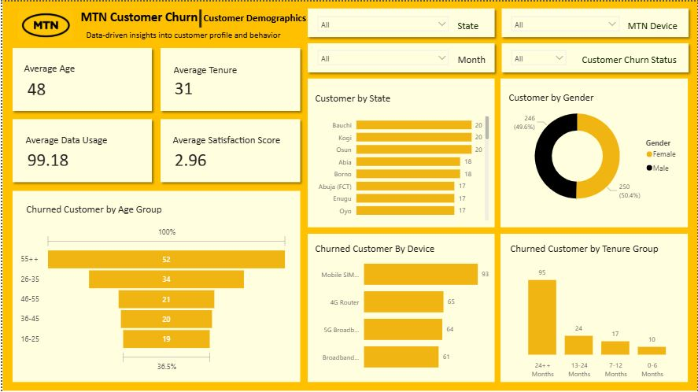
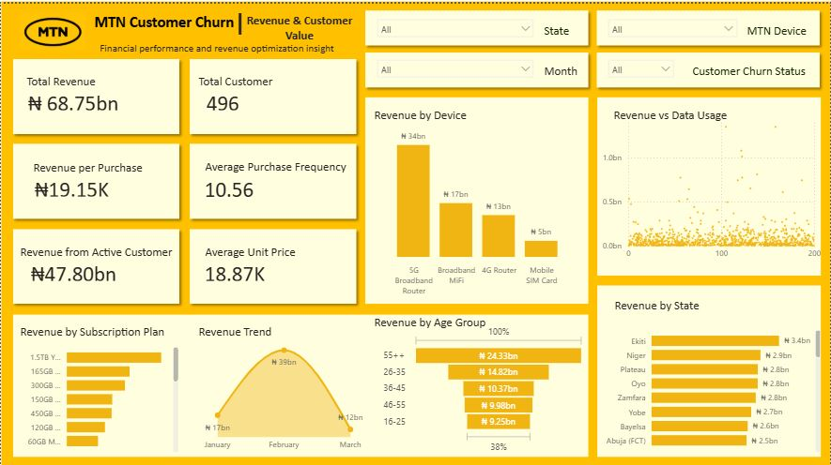
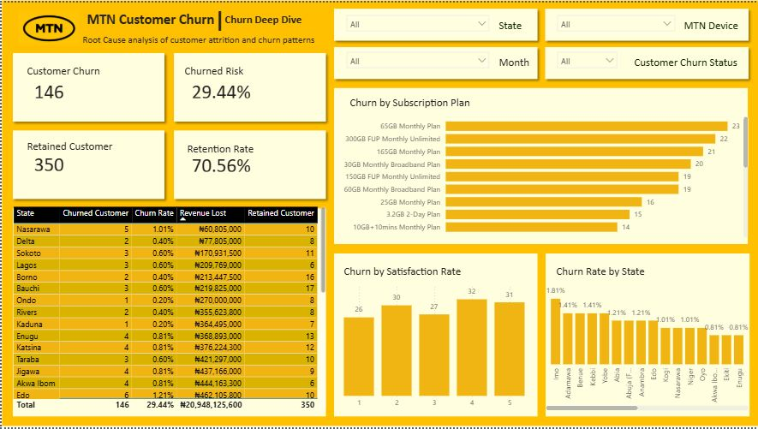
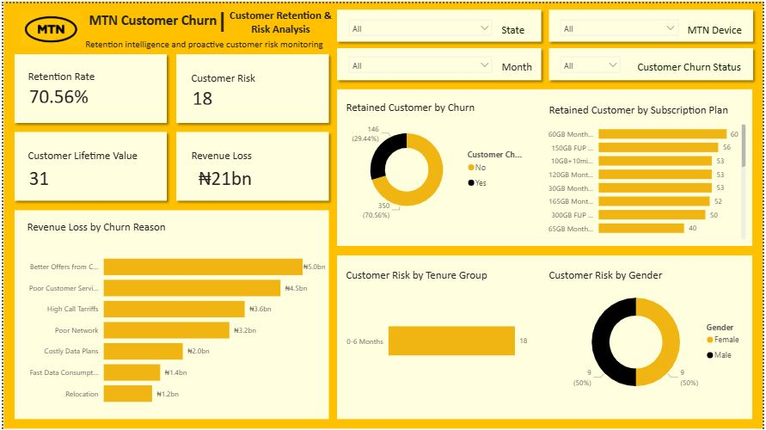
Dashboard Overview
MTN Customer Churn Analysis
Monitor business performance using executive KPIs
Understand customer demographics and behaviors
Identify revenue drivers and customer value
Discover the root causes of customer attrition
Recommend strategies to reduce churn and protect revenue

Slide 6
Executive Overview Dashboard
MTN generated a total revenue of 68.75 billion naira from 496 customers. Out of these customers, 146 customer have churned with overall churned rate of 29.44%. This means nearly one out of every three customers as left the network.
The average customer satisfaction is only 2.96 out of 5, suggesting many customers are not receiving the level of service expected. Customer lifetime value ranges between 32 and 39 across states, indicating varying customer profitability by location.
The highest churn rate are concentrated in specific states, suggesting that churn is influenced by regional factor rather than being evenly distributed. The leading churn reason includes:
Better competitor offers
Poor customer service
High call tariffs
Poor network quality
Business Problem: Customer attrition is eroding both revenue and long-term customer value. The current satisfaction score indicates underlying service quality issues, while concentrated regional churn suggests inconsistent customer experience across states.
Business impact are revenue leakage, reduced customer lifetime value, increase acquisition costs to replace lost customers and declining market competitiveness.

Slide 7
Customer Demographics Dashboard
The average customer age is 48 years while the average tenure is 31 months. The customers aged 55 years and above recorded the highest number of churned customers which is mostly occur within the first sic=x months of customer onboarding
The gender distribution is almost equal, indicating churn is not significantly influenced by gender. Mobile SIM user experience the highest churn compared to broadband and router customer. Certain states consistently report higher customer count, making them strategically importance markets.
Business problem: Customer retention effort are not adequately focused on the customer segments with highest churn risk. New Customers appear particularly vulnerable during the onboarding period.
Business impact is failure to retain customer acquisition costs and reduces long-term profitability.

Slide 8
Revenue & Customer Value Dashboard
Total revenue reached 68.75 billion naira with 47.80 billion naira coming from active customers. The average revenue per purchase is approximately nineteen thousand naira. 5G Broadband Routers generate the highest revenue among device categories.
Customer age 55years and above contribute the largest share of revenue. Revenue peaks in February before declining sharply in March, indicating possible seasonal purchasing patterns, higher data usage does not necessarily correspond to higher revenue, suggesting opportunities to optimize pricing and monetization
Business problem: Organization relies heavily on a limited number of customer segment and products for revenue generation
Business impact: Loss of premium customers could significantly reduce profitability.

Slide 9
Churn Deep Dive Dashboard
Customer retention currently stands at 70.56%, while 29.44% of customer have churned. The largest number of churned customers are subscribed to premium monthly plans, suggesting pricing or perceived value concerns,
The higher satisfaction score correspond with lower churn rate, reinforcing customer experience as a major retention driver, estimated revenue lost due to churn exceeds 20 billion naira.
Business problem: customer churn is primarily driven by preventable factors, including service quality , pricing concerns, and customer dissatisfaction
The Business impact continued churn at current level will reduce profitability, weaken market share, and increase marketing expenditure required to replace lost customers.

Slide 10
Customer Retention & Risk Dashboard
The analysis shows the retention rate is 70.56%. Revenue lost from churn is approximately 21 billion naira. The Largest revenue losses are associated with:
Better competitor offers
Poor customer service
High tariff
Poor network quality
Most retained customer belong to a few subscription plans, indicating strong customer preference for these offerings, customer risk is high during the first six(6) months of service. Gender has minimal influence on retention risk.
Business problem: The organization currently lack proactive customer retention strategies for high-risk customers. customer intervention often occur only after churn has already happened.
The business impact delayed intervention increase revenue loss and reduce the effectiveness of retention investments.

Slide 11
Strategic Recommendation
Based on the analysis, the following actions are recommended to reduce customer churn and improve customer retention:
Improve Customer Experience
Enhance network reliability and service quality
Reduce customer complaints through faster issue resolution
Continuously monitor customer satisfaction to identify service gaps
Implement Predictive Churn Analysis
Use historical customer data to identify subscribers at risk of churn
Proactively engage at-risk customers with personalized retention offers and support
Optimize Subscription Plans
Review pricing strategies and redesign underperforming plans
Introduce flexible bundles and loyalty rewards tailored to customer segments
Personalize Customer Engagement
Segment customer based on demographics, tenure, and usage patterns
Deliver targeted marketing campaigns and personalized promotions
Strengthen Customer Retention Programs
Reward long-term customer with exclusive benefits and incentives
Focus retention effort on early-tenure customer who are more likely to churn

Slide 12
Technical Stack
Tools Used
Microsoft Power BI
Interactive dashboard development
Data visualization
Executive reporting
Power Query
Data cleaning and transformation
Data quality improvement
DAX (Data Analysis Expression)
KPI’s calculation
Business measure
Time intelligence
Techniques Applied
ETL (Extract, Transform, Load)
Star Schema Data Modeling
Customer Segmentation
Revenue Analysis
Customer churn Analysis
KPI’s Development
Business Storytelling
Executive Decision Support

Slide 13
Lessons Learned
This project significantly strengthened my technical and analytical capabilities.
Technical Growth
Improved proficiency in Power BI, Power Query, and DAX
Gained practical experience in designing star schema data model
Learned how to build scalable and interactive dashboards
Business Understanding
Develop the ability to translate business problem into analytical solution
Strengthened skill in customer analytics, revenue analysis, and KPI’s design
Improve confidence in communicating insight to business stakeholders
Professional Development
Enhance analytical thinking and problem-solving skills
Learned the importance of data quality in producing reliable insights
Understood that effective Business Intelligent is about supporting business decisions, not just creating visualizations

Slide 14
Thank You

